Slide 1
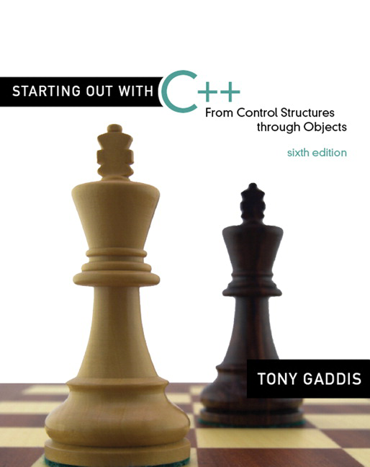

Chapter 11:
Structured Data
Copyright © 2009 Pearson Education, Inc. Publishing as Pearson Addison-Wesley

Slide 2
11.2
Combining Data into Structures

Slide 3
Combining Data into Structures
Structure: C++ construct that allows multiple variables to be grouped together
General Format:
  struct <structName>
  {
  type1 field1;
  type2 field2;
  . . .
  };
11-<number>

Slide 4
Example struct Declaration
  struct Student
  {
  int studentID;
  string name;
  short yearInSchool;
  double gpa;
  };
structure tag
structure members
11-<number>

Slide 5
struct Declaration Notes
Must have ; after closing }
struct names commonly begin with uppercase letter
Multiple fields of same type can be in comma-separated list:
  string name,
  address;
11-<number>

Slide 6
Defining Variables
struct declaration does not allocate memory or create variables
To define variables, use structure tag as type name:
  Student bill;
bill
studentID
name
yearInSchool
gpa
11-<number>

Slide 7
11.3
Accessing Structure Members

Slide 8
Accessing Structure Members
Use the dot (.) operator to refer to members of struct variables:
  cin >> stu1.studentID;
  getline(cin, stu1.name);
  stu1.gpa = 3.75;
Member variables can be used in any manner appropriate for their data type
11-<number>

Slide 9
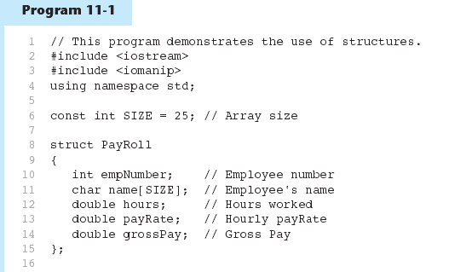
11-<number>

Slide 10
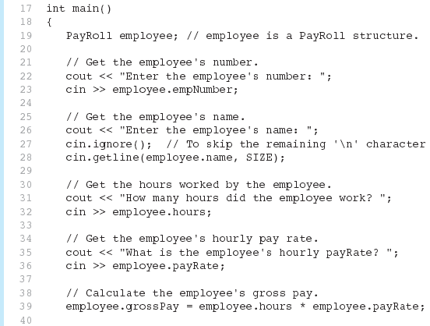
Program11-1 (Continued)
11-<number>

Slide 11
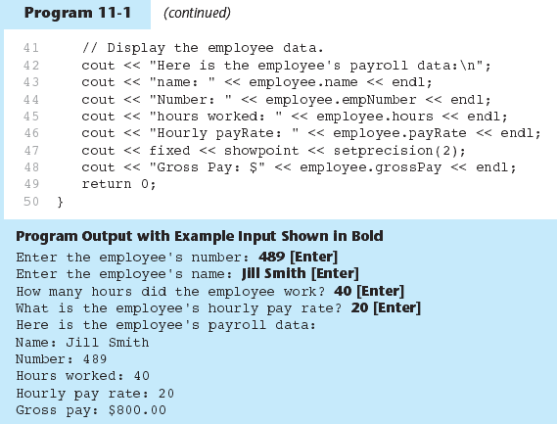
11-<number>

Slide 12
Displaying a struct Variable
To display the contents of a struct variable, must display each field separately, using the dot operator:
  cout << bill; // won’t work
  cout << bill.studentID << endl;
  cout << bill.name << endl;
  cout << bill.yearInSchool;
  cout << " " << bill.gpa;
11-<number>

Slide 13
Comparing struct Variables
Cannot compare struct variables directly:
  if (bill == william) // won’t work
Instead, must compare on a field basis:
  if (bill.studentID ==
  william.studentID) ...
11-<number>

Slide 14
11.4
Initializing a Structure

Slide 15
Initializing a Structure
struct variable can be initialized when defined:
  Student s = {11465, "Joan", 2, 3.75};
Can also be initialized member-by-member after definition:
  s.name = "Joan";
  s.gpa = 3.75;
11-<number>

Slide 16
More on Initializing a Structure
May initialize only some members:
  Student bill = {14579};
Cannot skip over members:
  Student s = {1234, "John", ,
  2.83}; // illegal
Cannot initialize in the structure declaration, since this does not allocate memory
11-<number>

Slide 17
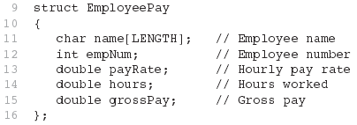
Excerpts From Program 11-4
11-<number>

Slide 18
11.5
Arrays of Structures

Slide 19
Arrays of Structures
Structures can be defined in arrays
Can be used in place of parallel arrays
const int NUM_STUDENTS = 20;
Student stuList[NUM_STUDENTS];
Individual structures accessible using subscript notation
Fields within structures accessible using dot notation:
  cout << stuList[5].studentID;
11-<number>

Slide 20
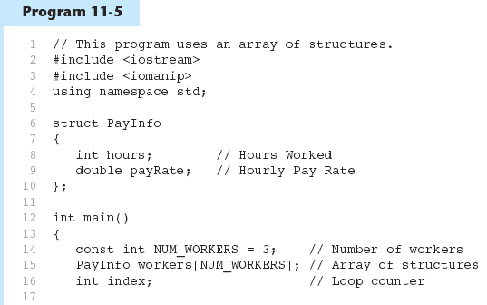
11-<number>

Slide 21
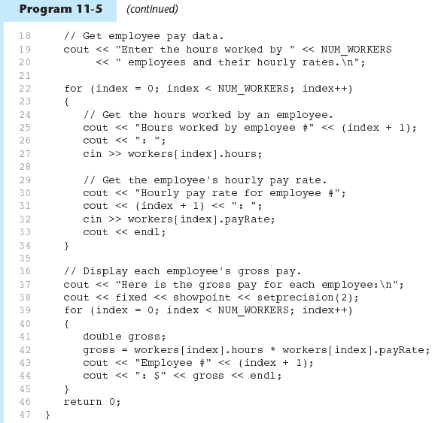
11-<number>

Slide 22
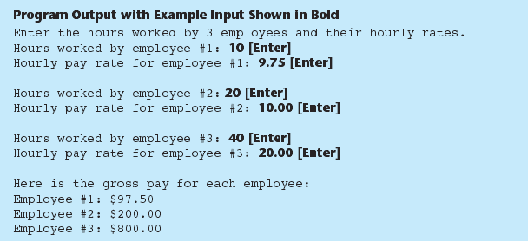
11-<number>

Slide 23
11.6
Nested Structures

Slide 24
Nested Structures
A structure can contain another structure as a member:
  struct PersonInfo
  { string name,
  address,
  city;
  };
  struct Student
  { int studentID;
  PersonInfo pData;
  short yearInSchool;
  double gpa;
  };
11-<number>

Slide 25
Members of Nested Structures
Use the dot operator multiple times to refer to fields of nested structures:
  Student s;
  s.pData.name = "Joanne";
  s.pData.city = "Tulsa";
11-<number>

Slide 26
11.7
Structures as Function Arguments

Slide 27
Structures as Function Arguments
May pass members of struct variables to functions:
  computeGPA(stu.gpa);
May pass entire struct variables to functions:
  showData(stu);
Can use reference parameter if function needs to modify contents of structure variable
11-<number>

Slide 28
11.8
Returning a Structure from a Function

Slide 29
Returning a Structure from a Function
Function can return a struct:
  Student getStudentData(); // prototype
  stu1 = getStudentData(); // call
Function must define a local structure
  for internal use
  for use with return statement
11-<number>

Slide 30
Returning a Structure from a Function - Example
  Student getStudentData()
  { Student tempStu;
  cin >> tempStu.studentID;
  getline(cin, tempStu.pData.name);
  getline(cin, tempStu.pData.address);
  getline(cin, tempStu.pData.city);
  cin >> tempStu.yearInSchool;
  cin >> tempStu.gpa;
  return tempStu;
  }
11-<number>

Slide 31
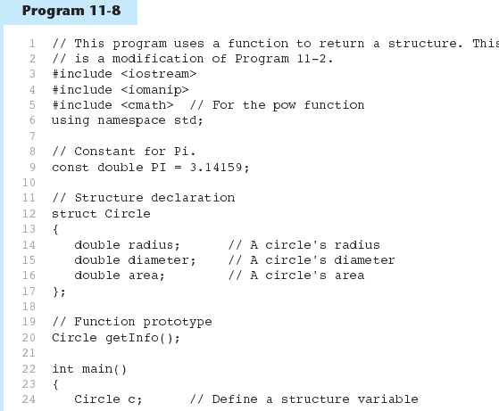
11-<number>

Slide 32
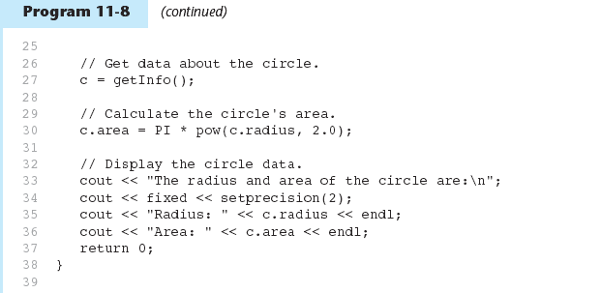
11-<number>

Slide 33
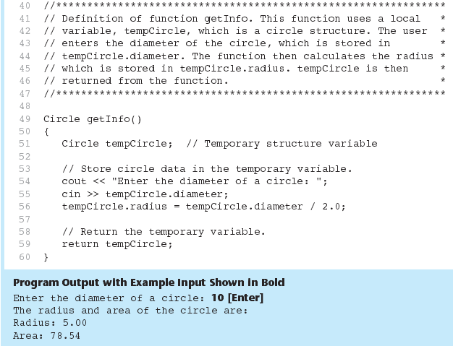
Program 11-8 (Continued)
11-<number>

Slide 34
11.9
Pointers to Structures

Slide 35
Pointers to Structures
A structure variable has an address
Pointers to structures are variables that can hold the address of a structure:
  Student *stuPtr;
Can use & operator to assign address:
  stuPtr = & stu1;
Structure pointer can be a function parameter
11-<number>

Slide 36
Accessing Structure Members via Pointer Variables
Must use () to dereference pointer variable, not field within structure:
  cout << (*stuPtr).studentID;
Can use structure pointer operator to eliminate () and use clearer notation:
  cout << stuPtr->studentID;
11-<number>

Slide 37
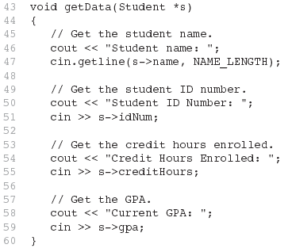
From Program 11-9
11-<number>

Slide 38
11.11
Unions

Slide 39
Unions
Similar to a struct, but
  all members share a single memory location, and
  only one member of the union can be used at a time
Declared using union, otherwise the same as struct
Variables defined as for struct variables
11-<number>

Slide 40
11.12
Enumerated Data Types

Slide 41
Enumerated Data Types
An enumerated data type is a programmer-defined data type. It consists of values known as enumerators, which represent integer constants.
11-<number>

Slide 42
Enumerated Data Types
Example:
enum Day { MONDAY, TUESDAY,
WEDNESDAY, THURSDAY,
FRIDAY };
The identifiers MONDAY, TUESDAY, WEDNESDAY, THURSDAY, and FRIDAY, which are listed inside the braces, are enumerators. They represent the values that belong to the Day data type.
11-<number>

Slide 43
Enumerated Data Types
enum Day { MONDAY, TUESDAY,
WEDNESDAY, THURSDAY,
FRIDAY };
Note that the enumerators are not strings, so they aren’t enclosed in quotes. They are identifiers.
11-<number>

Slide 44
Enumerated Data Types
Once you have created an enumerated data type in your program, you can define variables of that type. Example:
Day workDay;
This statement defines workDay as a variable of the Day type.
11-<number>

Slide 45
Enumerated Data Types
We may assign any of the enumerators MONDAY, TUESDAY, WEDNESDAY, THURSDAY, or FRIDAY to a variable of the Day type. Example:
workDay = WEDNESDAY;
11-<number>

Slide 46
Enumerated Data Types
So, what is an enumerator?
Think of it as an integer named constant
Internally, the compiler assigns integer values to the enumerators, beginning at 0.
11-<number>

Slide 47
Enumerated Data Types
enum Day { MONDAY, TUESDAY,
WEDNESDAY, THURSDAY,
FRIDAY };
In memory...
MONDAY = 0
TUESDAY = 1
WEDNESDAY = 2
THURSDAY = 3
FRIDAY = 4
11-<number>

Slide 48
Enumerated Data Types
Using the Day declaration, the following code...
cout << MONDAY << " "
<< WEDNESDAY << " “
<< FRIDAY << endl;
...will produce this output:
0 2 4
11-<number>

Slide 49
Assigning an integer to an enum Variable
You cannot directly assign an integer value to an enum variable. This will not work:
workDay = 3; // Error!
Instead, you must cast the integer:
workDay = static_cast<Day>(3);
11-<number>

Slide 50
Assigning an Enumerator to an int Variable
You CAN assign an enumerator to an int variable. For example:
int x;
x = THURSDAY;
This code assigns 3 to x.
11-<number>

Slide 51
Comparing Enumerator Values
Enumerator values can be compared using the relational operators. For example, using the Day data type the following code will display the message "Friday is greater than Monday.“
if (FRIDAY > MONDAY)
{
cout << "Friday is greater "
<< "than Monday.\n";
}
11-<number>

Slide 52
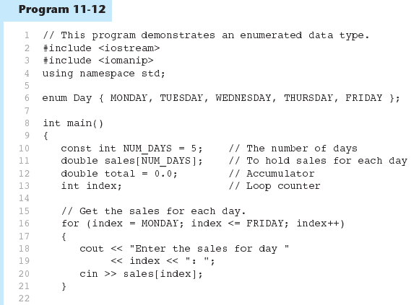
11-<number>

Slide 53
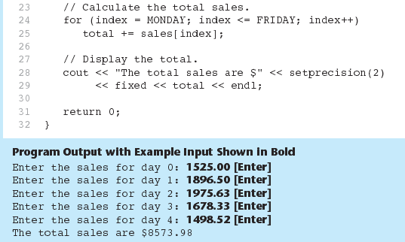
Program 11-12 (Continued)
11-<number>

Slide 54
Enumerated Data Types
Program 11-12 shows enumerators used to control a loop:
// Get the sales for each day.
for (index = MONDAY; index <= FRIDAY; index++)
{
cout << "Enter the sales for day "
<< index << ": ";
cin >> sales[index];
}
11-<number>

Slide 55
Typedef
Defines new data items equivalent to existing data types.
General format:
  Typedef datatype newtype;
Example:
  Typedef int integer;
11-<number>

